Slide 1
Hypothesis Testing

Slide 2
Hypothesis Testing
Tests to find evidence that our hypothesis/RQ/theory is correct
Tests to decide if a statistical relationship in our sample reflects a real relationship in the population or if it is due to chance (sampling error)

Slide 3
Hypothesis Testing
Easier to show/prove that nothing DOES NOT exist…
…rather than that something does exist

Slide 4
Hypothesis Testing
Easier to show/prove that “no relationship” DOES NOT exist…
…rather than that “a relationship” DOES exist
Before breathalyzers:
Sober drivers usually obey traffic laws, stay in lanes, and don’t slur their speech
(NOTHING alcoholic in system)
If driver is swerving; cop notices slurring and inability to walk, that is evidence against the nothing in system
(probably NOT NOTHING alcoholic in system)

Slide 5
Hypothesis Testing
First, develop hypothesis that nothing (no difference) exists, to disprove or reject it
Null Hypothesis (H₀)

Slide 6
Hypothesis Testing
Second, develop contradictory hypothesis that something (a difference) does exist
Alternative Hypothesis / Research Hypothesis (H₁ / H_{a})
Disproven null hypothesis lends support for research hypothesis

Slide 7
Hypothesis Testing
Looking for evidence AGAINST the null
Extreme associations between variables or extreme differences in means of groups
Lower likelihood that null is true
But what counts as extreme?

Slide 8
Hypothesis Testing and Bivariate relationships
Because we’re concerned with whether or not a true statistical relationship exists (in the population) between two or more variables, we begin with bivariate tests of association.

Slide 9
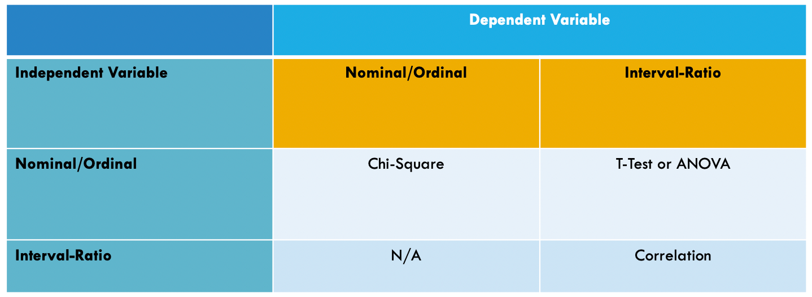
Hypothesis Testing and Bivariate relationships

Slide 10
Hypothesis Testing and Bivariate relationships
Chi Square Test of Independence (X²)
IV: categorical/discrete (e.g. nominal, ordinal)
DV: categorical/discrete (e.g. nominal, ordinal)
Independent Samples T-test (t)
IV: categorical/discrete (e.g. nominal, ordinal)
Only two groups/samples compared
DV: continuous (e.g. interval-ratio)
Analysis of Variance / ANOVA (F)
IV: categorical/discrete (e.g. nominal, ordinal)
Three or more groups/samples compared
DV: continuous (e.g. interval-ratio)
Correlation (r)
IV: continuous (e.g. interval-ratio)
DV: continuous (e.g. interval-ratio)

Slide 11
T-Test
(testing the difference between the means of two groups)

Slide 12
Hypothesis Testing w/ T-Test
We’re often concerned with differences between groups
Do conservatives and liberals differ in the severity of their discipline styles?
Want to compare discipline severity from both groups
Using the mean severity for each group.

Slide 13
Hypothesis Testing w/ T-Test
Is difference between group means ZERO (each group has the same mean)? If difference is not zero, is it because one group actually is more severe?
If difference is small, it might be due to chance (sampling error)
Samples just happened to have similar means
If difference is large, may be due to true difference in populations

Slide 14
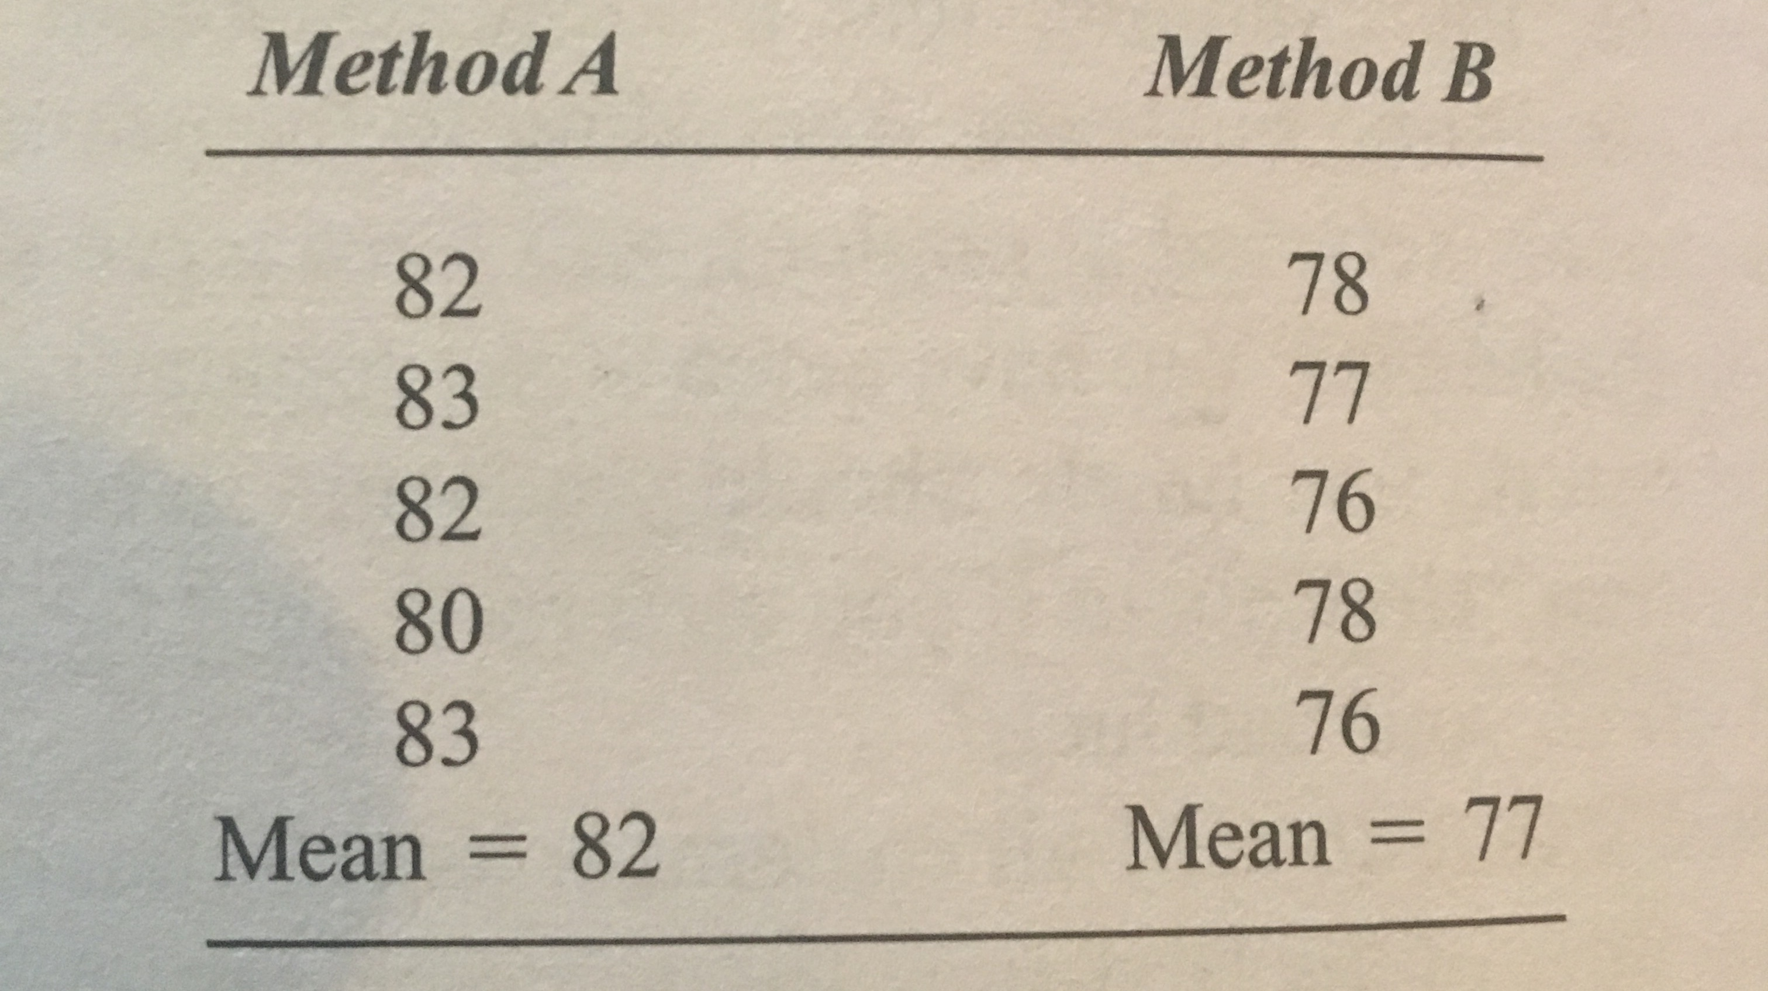
Example: Hypothesis Testing w/ T-Test
Gerontologist is studying two methods (A and B) for increasing memory of nursing home residents.
Randomly selects 10 residents and divides them into Method A or Method B.
Asks them all to take a recall test after exposure to method
Mean for group A is 82; Mean for group B is 77
How do we know if the difference is real or due to chance (sampling error)?

Slide 15
Example: Hypothesis Testing
Method A: consistently in low 80s
Method B: consistently in high 70s
Difference b/w groups probably not sampling error
Closeness (homogeneity) of scores in each group
No overlap in scores b/w groups
Method A likely better
But we have to do statistical hypothesis tests to see if this difference is actually the result of chance or sampling error, or a true difference between two groups in population

Slide 16
H₀: Null Hypothesis
There is no mean difference between the two groups, in the population. The mean of one group is equal to the mean of the other, in the population.
H₀: µ₁ ₌ µ₂
Any observed difference between samples is due to chance/sampling error and doesn’t represent a true difference between populations
Notes:
Mu 1 is mean of group 1 in pop, mu 2 is mean of group 2 in pop

Slide 17
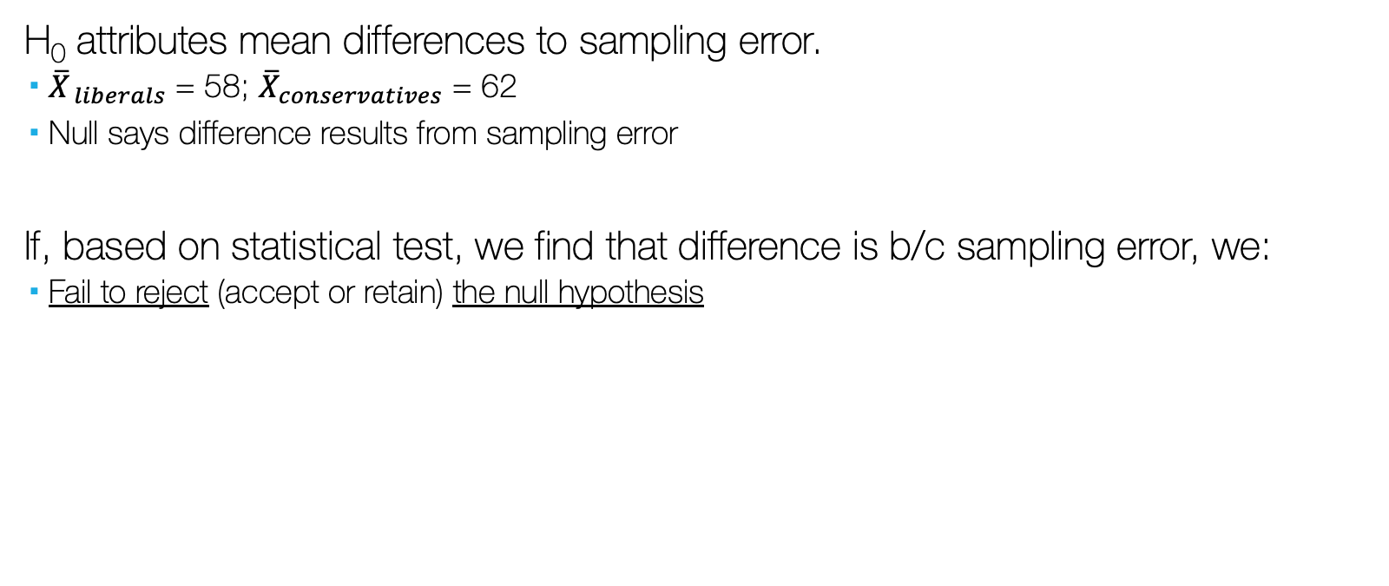
H_{0:} The Null Hypothesis
H₀ attributes mean differences to sampling error.
${\overline{X}}_{ liberals}$ = 58; ${\overline{X}}_{conservatives}$ = 62
Null says difference results from sampling error
If, based on statistical test, we find that difference is b/c sampling error, we:
Fail to reject (accept or retain) the null hypothesis

Slide 18
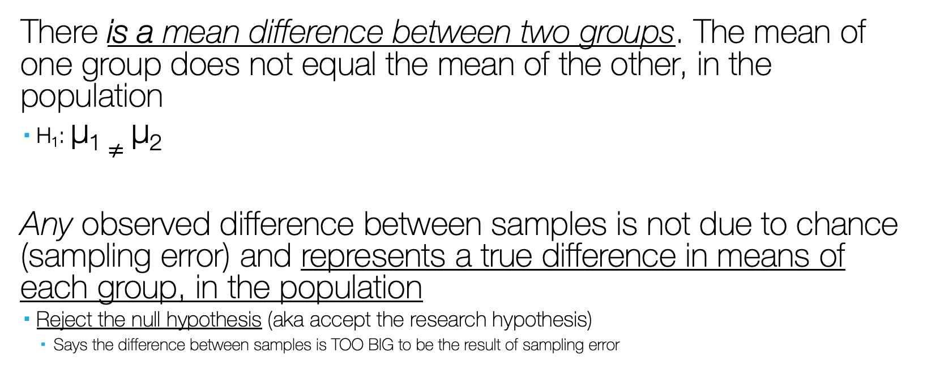
H₁: The Alternative Hypothesis
There is a mean difference between two groups. The mean of one group does not equal the mean of the other, in the population
H₁: µ₁ $≠$ µ₂
Any observed difference between samples is not due to chance (sampling error) and represents a true difference in means of each group, in the population
Reject the null hypothesis (aka accept the research hypothesis)
Says the difference between samples is TOO BIG to be the result of sampling error

Slide 19

H₁: The Alternative Hypothesis
Non-Directional Research Hypothesis
H₁: µ₁ $≠$ µ₂

Slide 20
Hypothesis Testing w/ T-test
We’re concerned with determining if there is evidence AGAINST the null (disprove) in favor of our research hypothesis
“What is the probability of getting these extreme of differences between groups, given that the null hypothesis is true?”

Slide 21
Distributions and Z-scores for t-test

Slide 22
Example: Differences between Means
Researcher wants to compare sex differences in child-rearing permissiveness
X = sex (male, female)
Y = permissiveness (scale of 1 (less permissive) to 100 (more permissive) )
Gives it to 1 random sample of two groups
30 males and 30 females
Finds females mean = 58.0; males mean = 54.0
Difference between (female and male) means = +4.0
Is this a true difference that occurs in the population or the result of sampling error?

Slide 23
Sampling Distribution of Differences between Means
We can use logic of normal distributions (sampling distributions of means) to construct a sampling distribution of differences between means
Shows us how likely our difference-between-means (58.0-54.0 = +4.0) is, in relation to all possible samples.

Slide 24
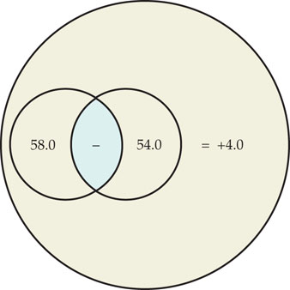
Sampling Distribution of Differences between Means
Before, he took 1 pair of random samples (30 females and 30 males)
Found a difference-between-means of +4.0 points

Slide 25
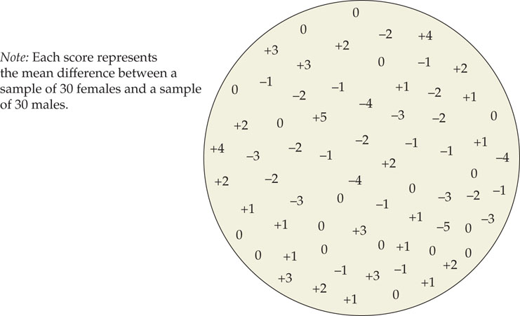
Sampling Distribution of Differences between Means
Now, assume he took 70 pairs of random samples (each with 30 females and 30 males)
He could calculate a difference-between-means score for each pair of samples

Slide 26
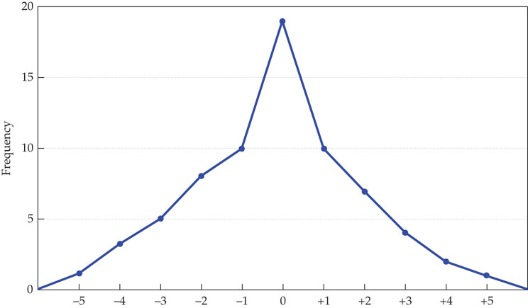
Sampling Distribution of Differences between Means
If we plotted these difference-between-mean values on a frequency distribution, it would be approximately a normal curve

Slide 27
Sampling Distribution of Differences between Means
This curve also approximates the null hypothesis
That there is NO MEAN DIFFERENCE between the two samples
Which is why more scores around 0 (meaning the difference between each pair of samples is zero)

Slide 28
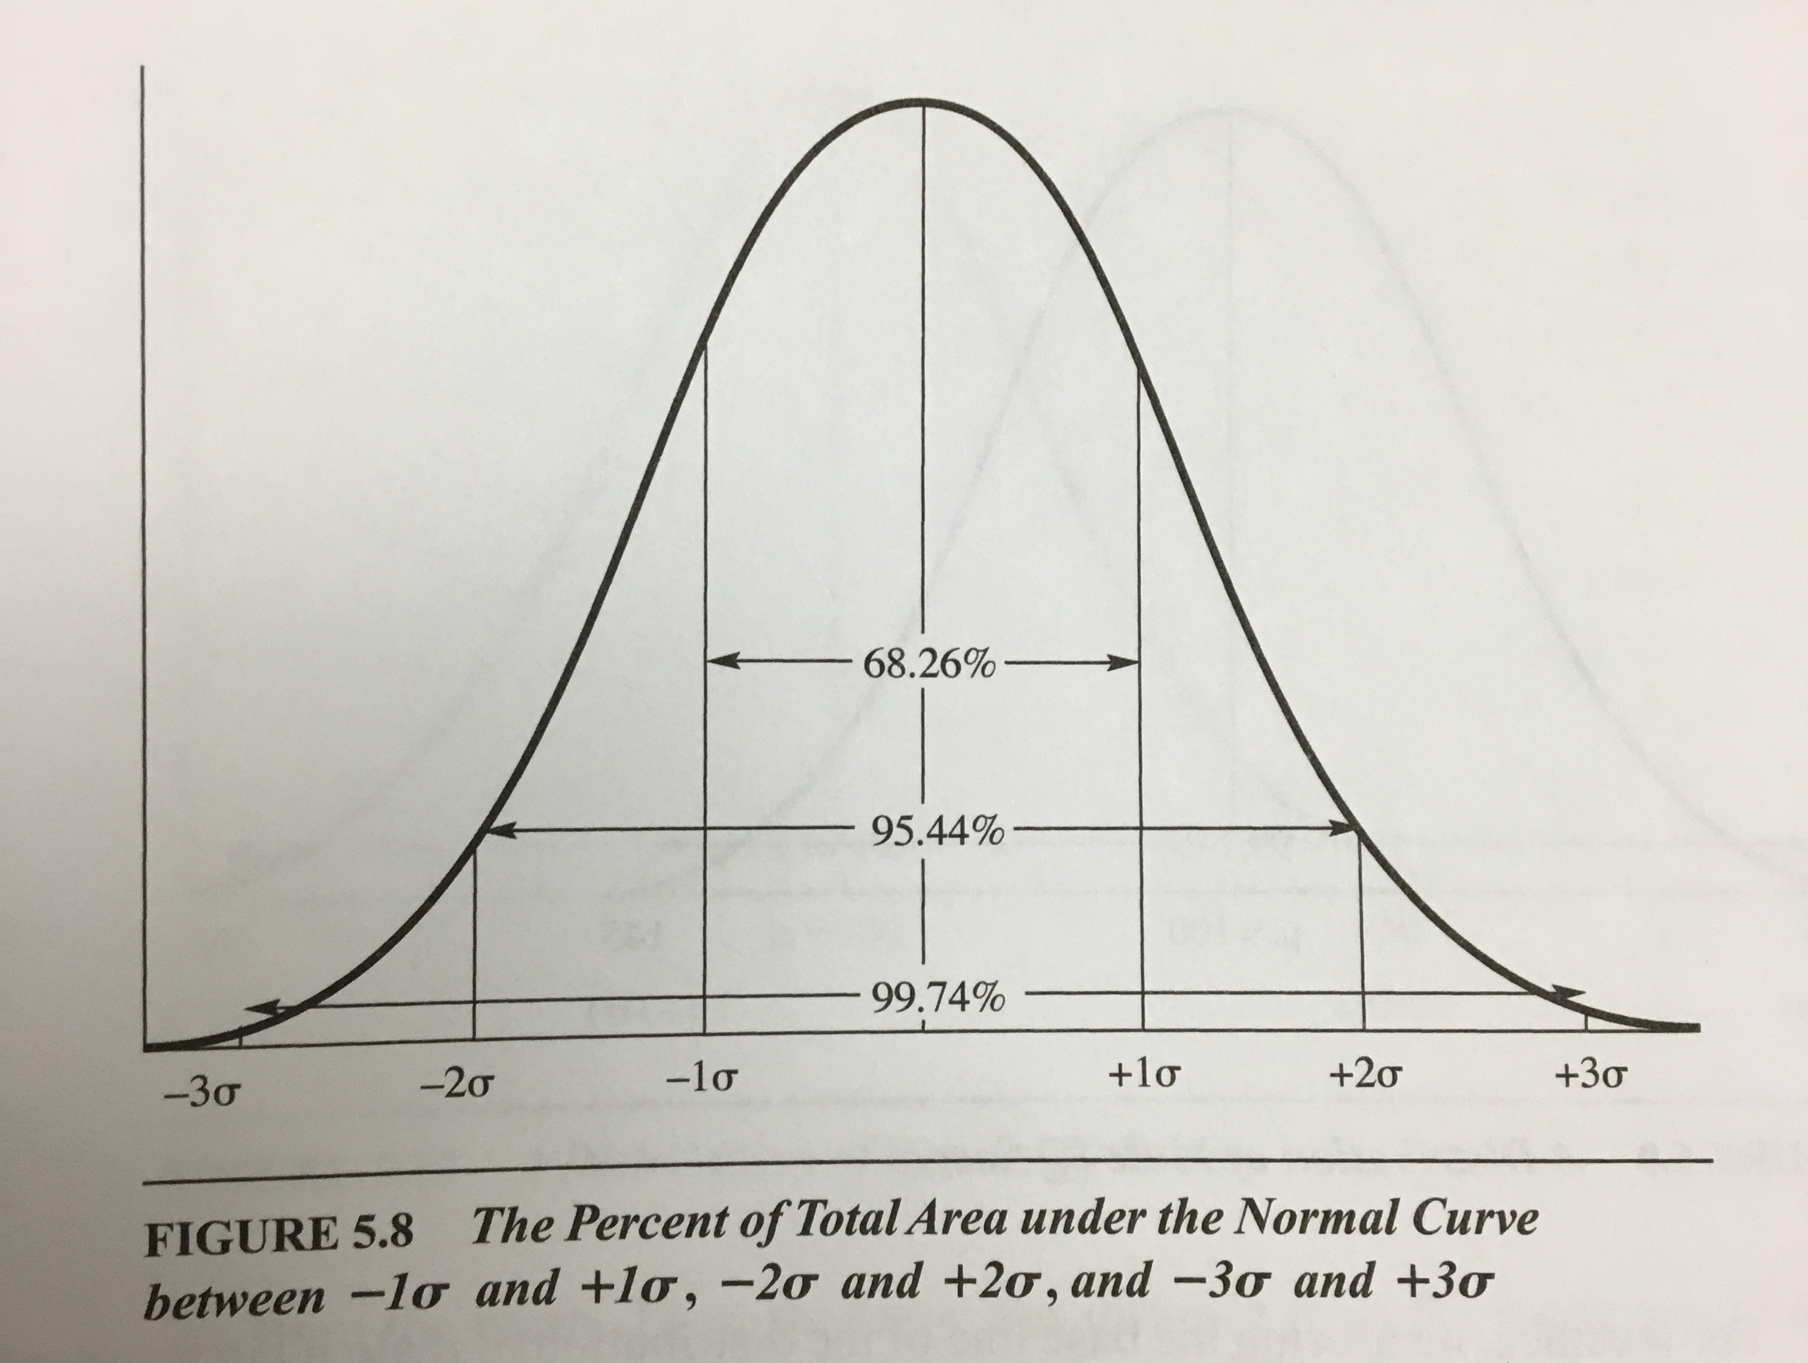
Recall: Distributions
Because it approximates the normal curve, we can identify which percentage of cases (differences between sample means) fall between
-1 and +1 standard deviation units:
68.26%
-2 and +2 standard deviation units:
95.44%
-1.96 and +1.96 standard deviation units:
95.00%
-3 and +3 standard deviation units:
99.74%
-2.58 and +2.58 standard deviation units:
99.00%

Slide 29
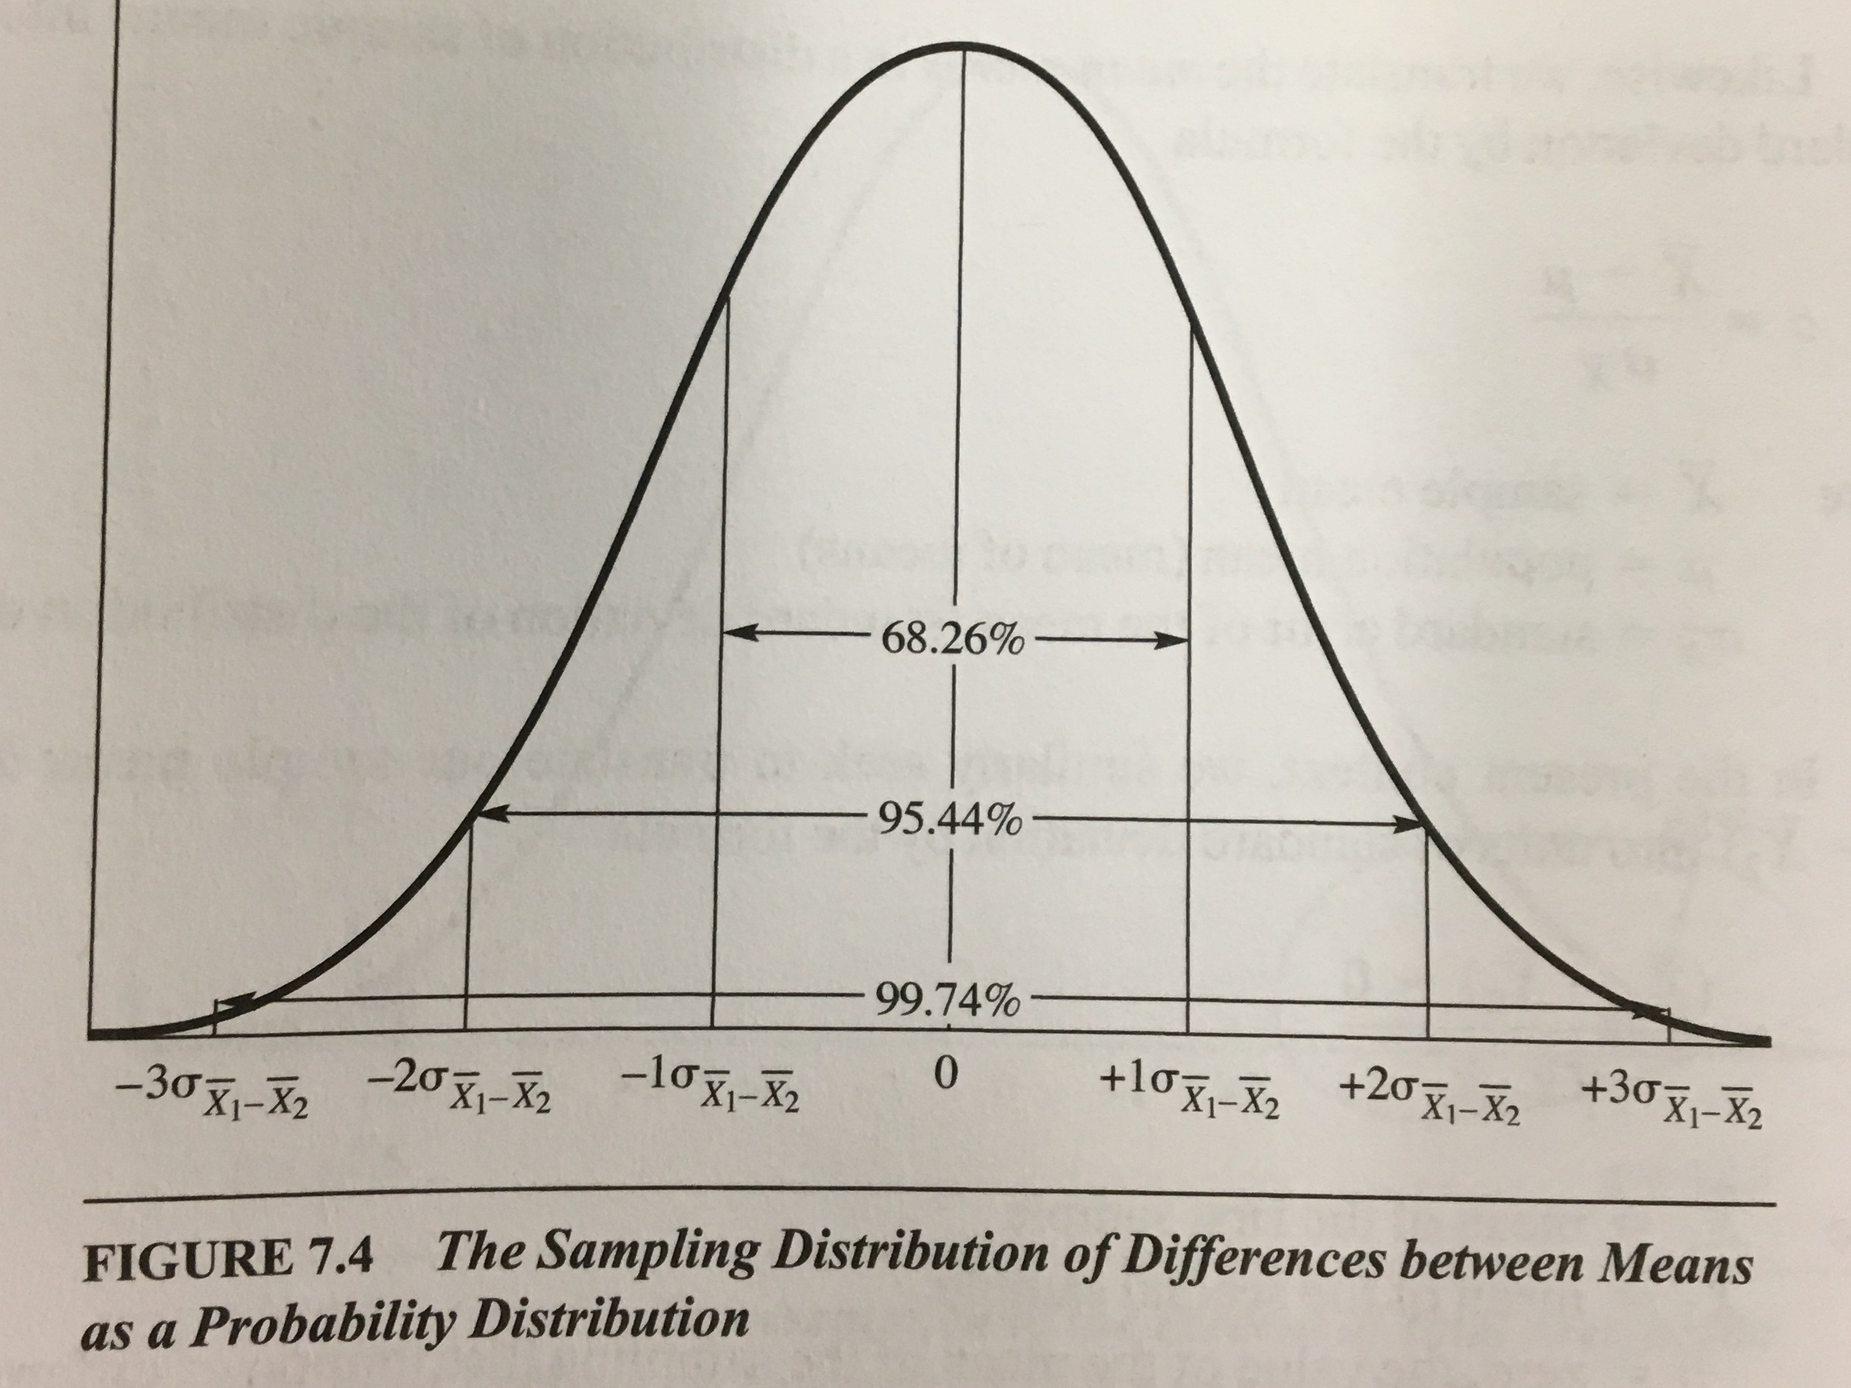
Sampling Distribution of Differences between Means
Because it approximates the normal curve, we can identify which percentage of cases (differences between sample means) fall between
-1 and +1 standard deviation units:
68.26%
-2 and +2 standard deviation units:
95.44%
-1.96 and +1.96 standard deviation units:
95.00%
-3 and +3 standard deviation units:
99.74%
-2.58 and +2.58 standard deviation units:
99.00%

Slide 30
Z-scores as (Extreme) evidence against null for t-test

Slide 31
Hypothesis Testing
Looking for evidence AGAINST the null
Extreme mean differences = evidence AGAINST NULL
Extreme mean differences = further away from null
Lower likelihood that null is true
But what counts as extreme?

Slide 32
Evidence against Null = Extreme Z-score
Z-score used to find probability of obtaining scores at or below/at or above for
Probability Distributions
an individuals score relative to the population
Sampling Distributions
the mean of a sample relative to all possible samples

Slide 33
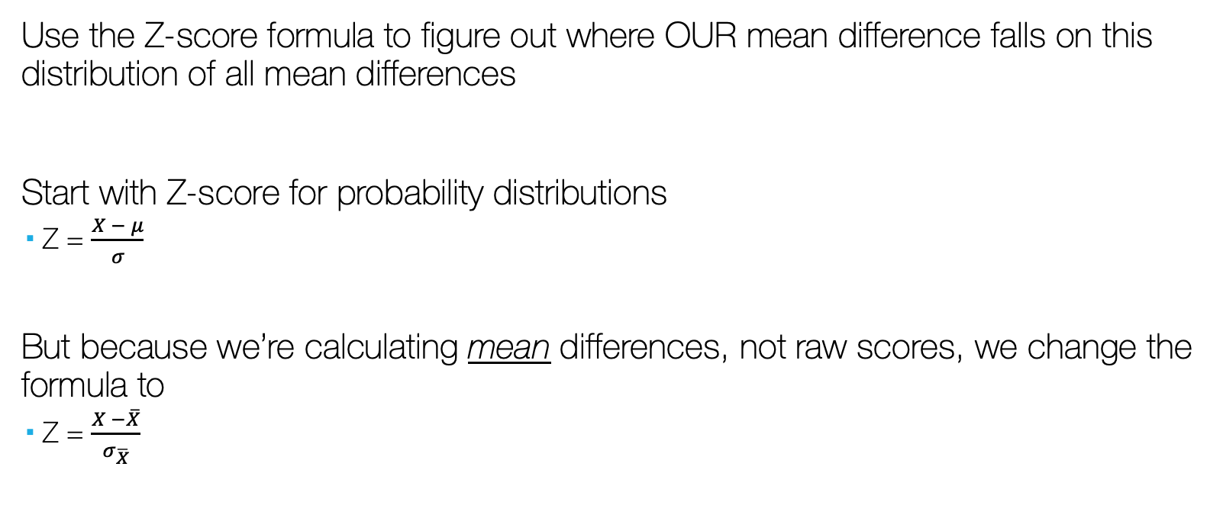
Sampling Distribution of Differences between Means
Use the Z-score formula to figure out where OUR mean difference falls on this distribution of all mean differences
Start with Z-score for probability distributions
Z = $\frac{X − μ}{σ}$
But because we’re calculating mean differences, not raw scores, we change the formula to
Z = $\frac{X −\overline{X}}{σ_{\overline{X}}}$

Slide 34

Sampling Distribution of Differences between Means
Because we’re calculating mean differences, not just means, we change the formula to
Z = $\frac{\left({\overline{X}}_{1} −{\overline{X}}_{2}\right)−0}{σ_{{\overline{X}}_{1} −{\overline{X}}_{2}}}$
0 because the null assumes that the mean of the sampling distribution of means is zero
But the zero cancels out, so we’re left with…
Z = $\frac{\left({\overline{X}}_{1} −{\overline{X}}_{2}\right)}{σ_{{\overline{X}}_{1} −{\overline{X}}_{2}}}$

Slide 35
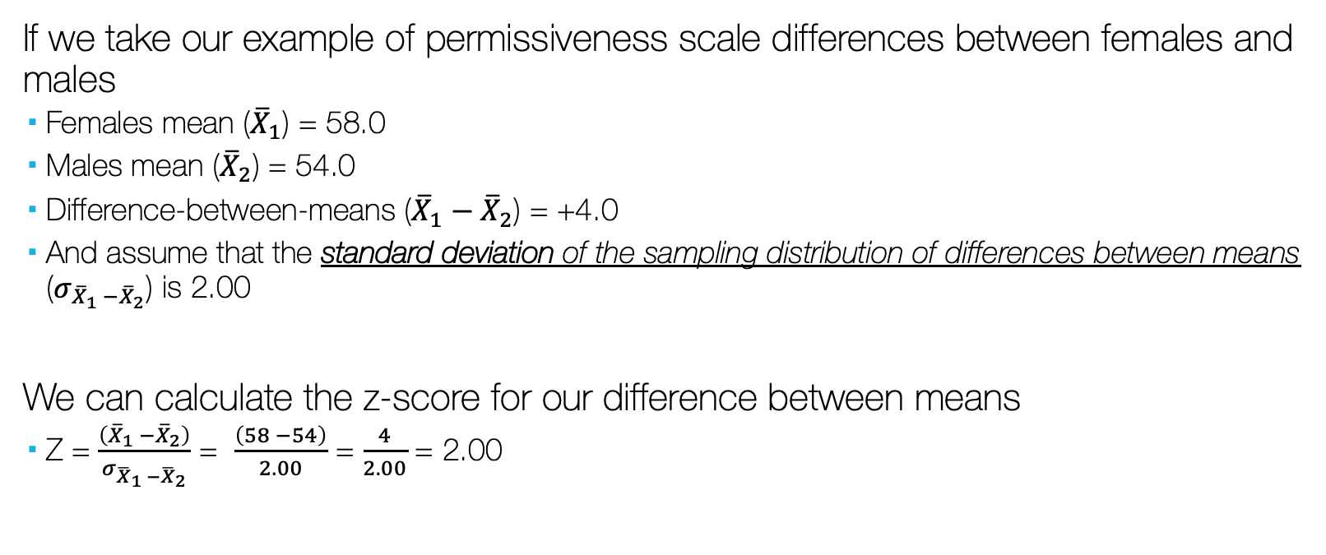
Sampling Distribution of Differences between Means
If we take our example of permissiveness scale differences between females and males
Females mean (${\overline{X}}_{1}$) = 58.0
Males mean (${\overline{X}}_{2}$) = 54.0
Difference-between-means (${\overline{X}}_{1}−{\overline{X}}_{2}$) = +4.0
And assume that the standard deviation of the sampling distribution of differences between means ($σ_{{\overline{X}}_{1} −{\overline{X}}_{2}}$) is 2.00
We can calculate the z-score for our difference between means
Z = $\frac{\left({\overline{X}}_{1} −{\overline{X}}_{2}\right)}{σ_{{\overline{X}}_{1} −{\overline{X}}_{2}}}$ = $\frac{\left(58 −54\right)}{2.00}$ = $\frac{4}{2.00}$ = 2.00

Slide 36
Sampling Distribution of Differences between Means
But what if we switched groups so that males were group 1?

Slide 37

Sampling Distribution of Differences between Means
Females mean (${\overline{X}}_{2}$) = 58.0
Males mean (${\overline{X}}_{1}$) = 54.0
Difference-between-means would be negative (${\overline{X}}_{1}−{\overline{X}}_{2}$) = -4.0
So the z-score would also be negative
Z = $\frac{\left({\overline{X}}_{1} −{\overline{X}}_{2}\right)}{σ_{{\overline{X}}_{1} −{\overline{X}}_{2}}}$ = $\frac{\left(54 −58\right)}{2.00}$ = $\frac{−4}{2.04}$ = -2.00

Slide 38
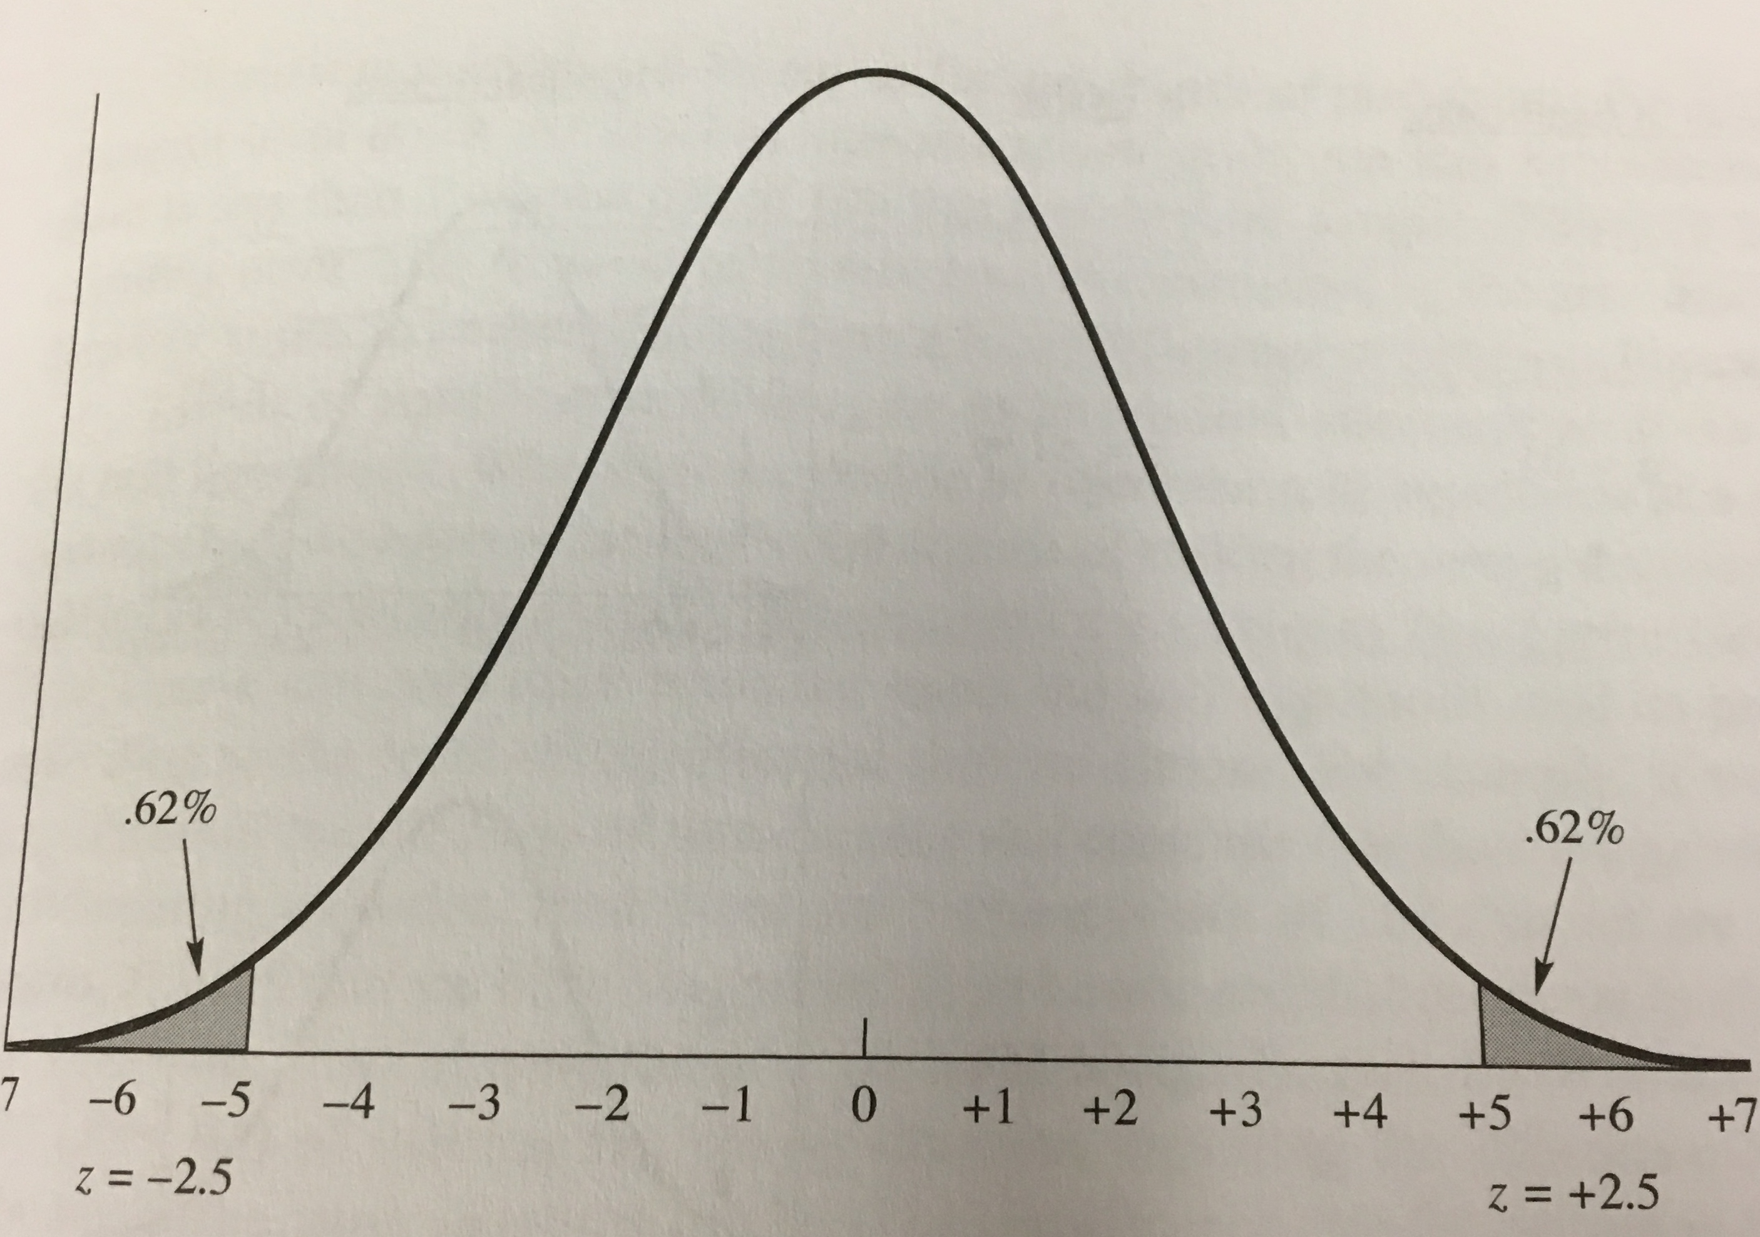
Sampling Distribution of Differences between Means
We have two z-scores… (one positive, one negative)
This means that the z-scores are tested based on the two tails of the distribution

Slide 39

But what is an extreme Z-score?
Our calculated Z score (Z_{calculated}) = $±$2.00
But is a Z score of $±$2.00 extreme enough?

Slide 40
But what is an extreme Z-score?
Need a cutoff Z score to compare with our calculated Z-score

Slide 41
But what is an extreme Z-score?
Z_{critical}
Our cutoff Z score
Stays the same, selected before analyzing differences
Z_{calculated}
Our calculated Z for our mean difference

Slide 42

But what is an extreme Z-score?
Extreme Z-score (extreme mean difference) if:
| Z_{calculated} | $≥$ | Z_{critical} |

Slide 43
But what is an extreme Z-score?
Cutoff Z score (Z_{critical}) identifies a point, and percent likelihood (or probability) that the null is TRUE
We want a low percent chance that the null is true
When comparing to our calculated Z-score (Z_{calculated}), tells us whether a difference between a pair of sample means is/isn’t extreme enough that it can’t be attributed to sampling error

Slide 44
Critical z-scores

Slide 45


Cutoff Z-score (Z_{critical}), and Statistical Significance ($α$ and p)
How is Z_{critical} selected?
Z_{critical} is based on $α$, or the maximum allowed probability that the null will be true

Slide 46

Cutoff Z-score (Z_{critical}), and Statistical Significance ($α$ and p)
Alpha ($α$)
Cutoff for rejection region (tails)

Slide 47

Cutoff Z-score (Z_{critical}), and Statistical Significance ($α$ and p)
Alpha ($α$) = .05
5% chance null hypothesis is true
5% of mean differences/cases considered extreme (rejection region)
5% cases left in tails of distribution
.05 maximum allowed probability that the null is true
Associated Z score (Z_{critical}) = $±$1.96

Slide 48
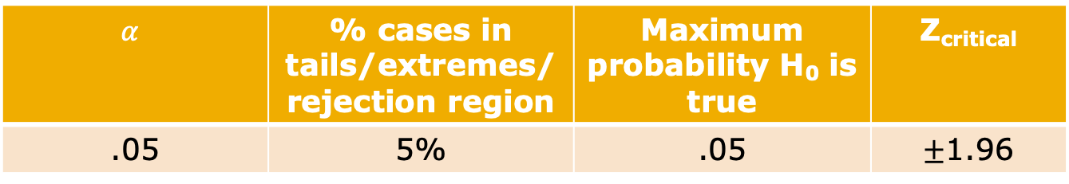
Cutoff Z-score (Z_{critical}), and Statistical Significance ($α$ and p)
$$α$$ | % cases in tails/extremes/rejection region | Maximum probability H₀ is true | Z_{critical}
.05 | 5% | .05 | $±$1.96

Slide 49

Cutoff Z-score (Z_{critical}), and Statistical Significance ($α$ and p)
If | Z_{calculated} | $≥$ | Z_{critical} |
Calculated mean difference is more extreme than our cutoff for “extremeness”
Calculated mean difference is extremely different from what is expected by the null hypothesis
Statistically significant (extreme) mean difference from what what was expected by the null hypothesis

Slide 50

Cutoff Z-score (Z_{critical}), and Statistical Significance ($α$ and p)
For $α$ = .05
If | Z_{calculated} | $≥$ | $±$1.96 |
Calculated mean difference is more extreme than our cutoff for “extremeness”
Calculated mean difference is extremely different from what is expected by the null hypothesis
Statistically significant (extreme) mean difference from what what was expected by the null hypothesis

Slide 51

Cutoff Z-score (Z_{critical}), and Statistical Significance ($α$ and p)
Z = $±$1.96 spans 95% of all cases around the mean
Total of 5% of cases are between the Z-scores and their closest tails, Z score and more extreme
2.5% of all possible mean differences are in the top end of the distribution
2.5% of all mean differences in the bottom end of the distribution

Slide 52

Cutoff Z-score (Z_{critical}), and Statistical Significance ($α$ and p)
For = $±$1.96
There is a only a 5% chance, or .05 maximum probability that our mean difference or *more* extreme occurred because of sampling error
Very unlikely that this mean difference was because of sampling error
Therefore, if its not because of sampling error… we REJECT THE NULL HYPOTHESIS that there is no mean difference between the two populations.

Slide 53

Cutoff Z-score (Z_{critical}), and Statistical Significance ($α$ and p)
If alpha is very small, it is harder and harder to reject the null hypothesis
Smaller rejection regions
More stringent requirements for rejecting the null
What if you set alpha (the maximum probability that the null hypothesis is allowed to be true) to a smaller number
$α$ = .01
$α$ = .001

Slide 54
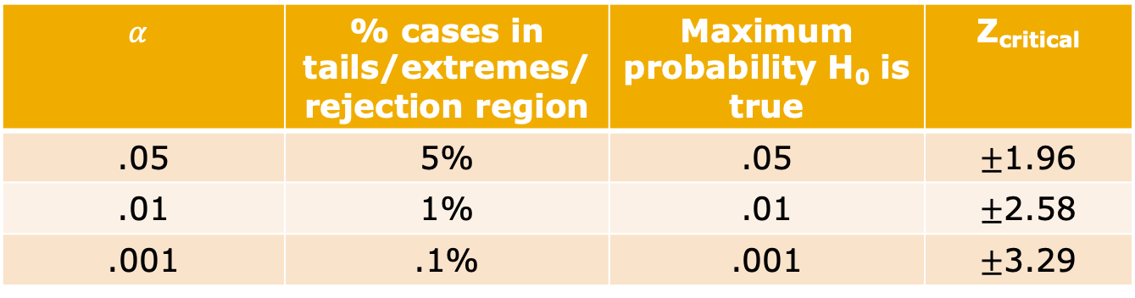

Statistical Significance ($α$ and p)
$$α$$ | % cases in tails/extremes/rejection region | Maximum probability H₀ is true | Z_{critical}
.05 | 5% | .05 | $±$1.96
.01 | 1% | .01 | $±$2.58
.001 | .1% | .001 | $±$3.29

Slide 55

Cutoff Z-score (Z_{critical}), and Statistical Significance ($α$ and p)
For $α$ = .01
If | Z_{calculated} | $≥$ | $±$2.58 |
Calculated mean difference is more extreme than our cutoff for “extremeness”
Calculated mean difference is extremely different from what is expected by the null hypothesis
Statistically significant (extreme) mean difference from what what was expected by the null hypothesis

Slide 56

Cutoff Z-score (Z_{critical}), and Statistical Significance ($α$ and p)
For $α$ = .001
If | Z_{calculated} | $≥$ | $±$3.29 |
Calculated mean difference is more extreme than our cutoff for “extremeness”
Calculated mean difference is extremely different from what is expected by the null hypothesis
Statistically significant (extreme) mean difference from what what was expected by the null hypothesis

Slide 57
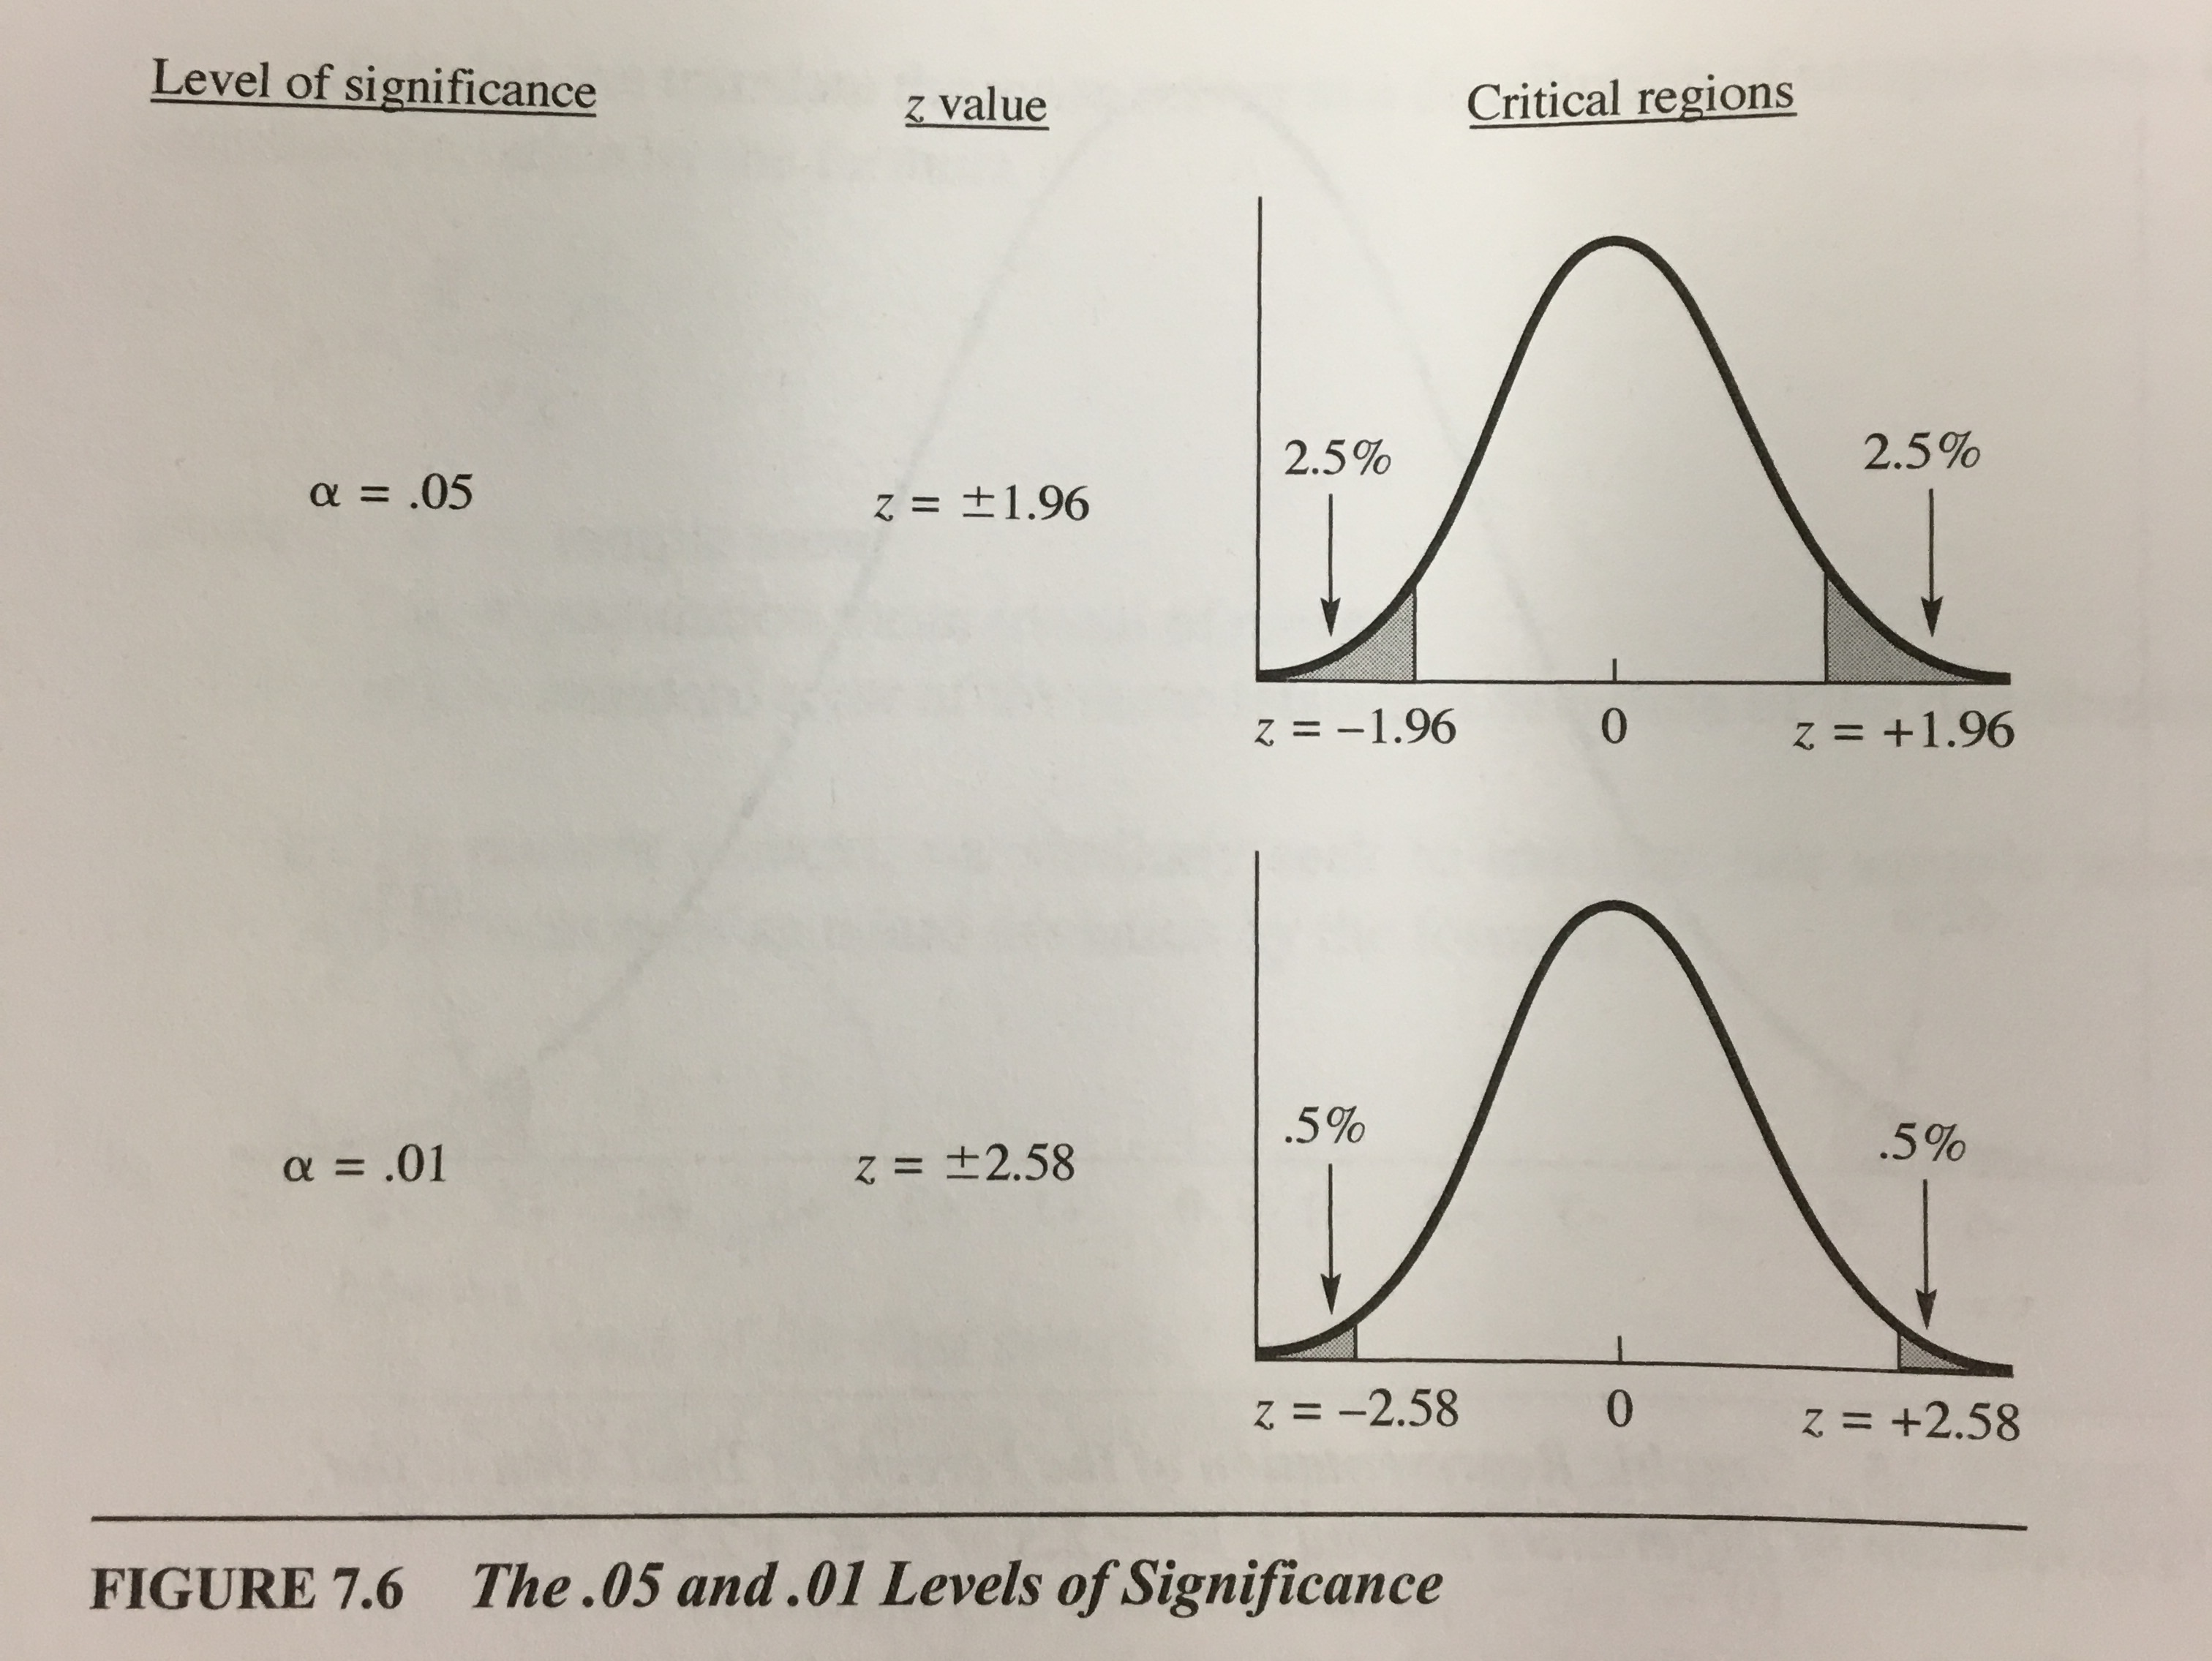
Cutoff Z-score (Z_{critical}), and Statistical Significance ($α$ and p)

Slide 58

Cutoff Z-score (Z_{critical}), and Statistical Significance ($α$ and p)
While $α$ is the maximum probability allowed for the null to be true (a cutoff)…
p is different

Slide 59
Cutoff Z-score (Z_{critical}), and Statistical Significance ($α$ and p)
Probability (p)
Actual probability of finding this extreme of a difference if the null hypothesis is true
Probability that the null hypothesis is true, given this extreme of a difference
Area from that Z score to the closest tails.

Slide 60

Cutoff Z-score (Z_{critical}), and Statistical Significance ($α$ and p)
Difference between p and $α$
$α$
A threshold selected beforehand
Has associated Z_{critical}
p
Based on the data
Exact probability of finding this difference, if the null hypothesis is true
Based on Z_{calculated}

Slide 61

Cutoff Z-score (Z_{critical}), and Statistical Significance ($α$ and p)
For difference to be extreme, we need:
| Z_{calculated} | $≥$ | Z_{critical} |
If | Z_{calculated} | $≥$ | Z_{critical} | , then..
the area in the extremes of Z_{calculated} (p, or the exact probability that the null is true for THIS difference) should be smaller than the area in the extremes of the cutoff of Z_{critical} ($α$, or the maximum probability that the null hypothesis is true)

Slide 62

Cutoff Z-score (Z_{critical}), and Statistical Significance ($α$ and p)
If | Z_{calculated} | $≥$ | Z_{critical} | , then…
Difference between mean of group 1 and mean of group 2 is so extreme that we can’t blame it on sampling error, therefore… H₀ is probably not true, so…
Z_{calculated} is in rejection region
Reject H₀
p $≤α$

Slide 63

Cutoff Z-score (Z_{critical}), and Statistical Significance ($α$ and p)
If | Z_{calculated} | $≥$ | $±$1.96 | , then..
Reject H₀
p $≤$.05

Slide 64

Cutoff Z-score (Z_{critical}), and Statistical Significance ($α$ and p)
If | Z_{calculated} | $≥$ | $±$2.58 | , then..
Reject H₀
p $≤$.01

Slide 65

Cutoff Z-score (Z_{critical}), and Statistical Significance ($α$ and p)
Difference between p and $α$
If p is less than or equal to $α$, the null hypothesis is considered to be false, so we reject it:
Statistically Significant Difference: p $≤$ $α$ OR p $≤$ .05

Slide 66

But what is an extreme Z-score?
In our example, our Z = $±$2.00
What is $α$?
What is p?
Do we reject or fail to reject?

Slide 67
Errors
If we set our alpha at too lenient a level (e.g. $α$ = .10) or too stringent a level (e.g. $α$ = .0001), we can run into errors…

Slide 68
Type I and Type II Errors
Type I error
We reject the null hypothesis when we shouldn’t have
Happens when we have too lenient an alpha (e.g. $α$ = .10)
Type II error
We fail to reject the null hypothesis when we should have
Happens when we have too stringent an alpha (e.g. $α$ = .0001)

Slide 69
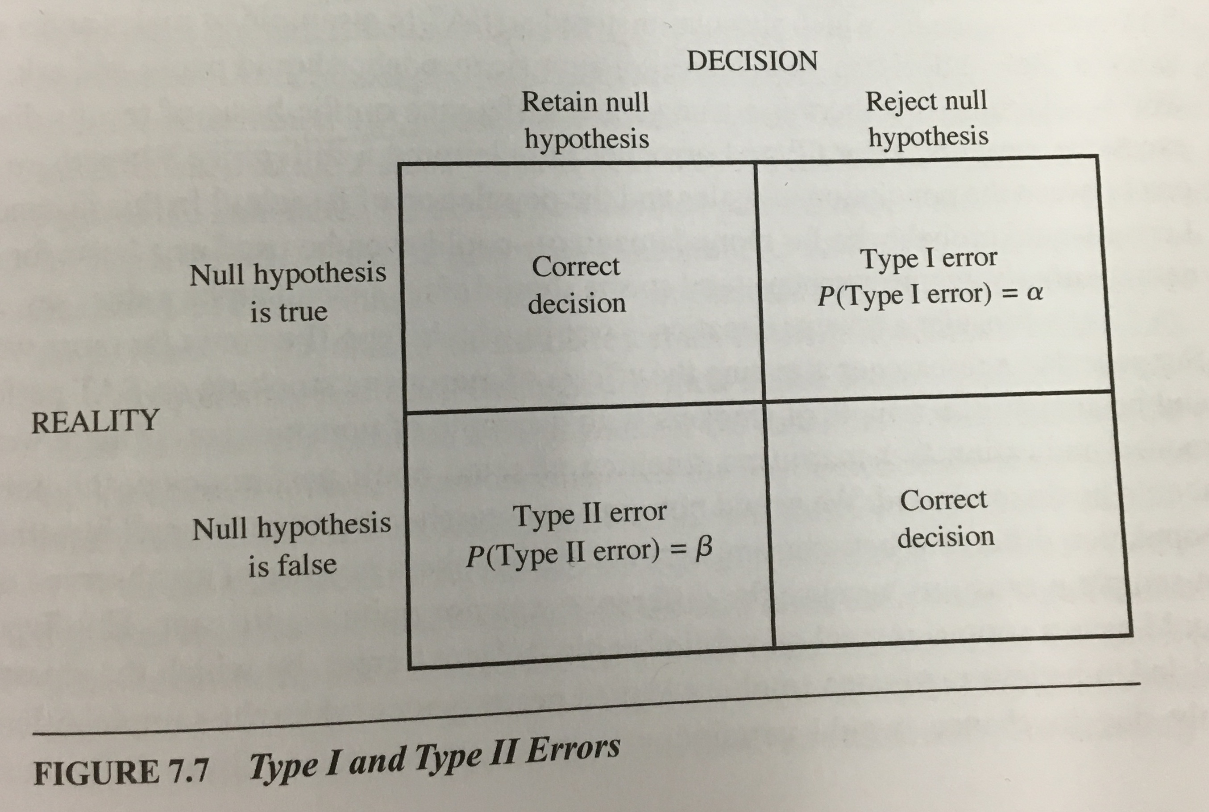
Type I and Type II Errors
Inverse relationship
The larger the probability of committing a Type I error, the smaller the probability of committing a Type II error

Slide 70

Back to Hypothesis Testing
Remember Z-score formula:
Z = $\frac{\left({\overline{X}}_{1} −{\overline{X}}_{2}\right)}{σ_{{\overline{X}}_{1} −{\overline{X}}_{2}}}$
But we never truly know $σ_{{\overline{X}}_{1} −{\overline{X}}_{2}}$, the standard deviation of the sampling distribution of the difference between means
So we have to estimate it

Slide 71
Back to Hypothesis Testing
Similar to Standard Error of the Mean
Never truly know standard deviation of the population, or the standard deviation of the sampling distribution, since we don’t actually take multiple samples
So we estimate the standard deviation of the sampling distribution of difference between means from our one (paired) sample
Standard Error of the Difference between Means

Slide 72

Back to Hypothesis Testing
Estimating the Standard Deviation of the Sampling Distribution of the Difference between Means
Standard Error of the Difference
$σ_{{\overline{X}}_{1} −{\overline{X}}_{2}} ≈ {SD}_{{\overline{X}}_{1} −{\overline{X}}_{2}}$ = $\sqrt{\left(\frac{{SD}_{1}^{2}}{N_{1}}\right)+\left(\frac{{SD}_{2}^{2}}{N_{2}}\right)}$

Slide 73

Back to Hypothesis Testing
So our Z-score formula becomes:
Z = $\frac{\left({\overline{X}}_{1} −{\overline{X}}_{2}\right)}{{SD}_{{\overline{X}}_{1} −{\overline{X}}_{2}}}$ = $\frac{\left({\overline{X}}_{1} −{\overline{X}}_{2}\right)}{\sqrt{\left(\frac{{SD}_{1}^{2}}{N_{1}}\right)+\left(\frac{{SD}_{2}^{2}}{N_{2}}\right)}}$

Slide 74

Back to Hypothesis Testing
But when we substitute Standard Error of the Difference, the distribution becomes a t-distribution, making this a t-test:
t = $\frac{\left({\overline{X}}_{1} −{\overline{X}}_{2}\right)}{{SD}_{{\overline{X}}_{1} −{\overline{X}}_{2}}}$ = $\frac{\left({\overline{X}}_{1} −{\overline{X}}_{2}\right)}{\sqrt{\left(\frac{{SD}_{1}^{2}}{N_{1}}\right)+\left(\frac{{SD}_{2}^{2}}{N_{2}}\right)}}$

Slide 75
The t-test

Slide 76
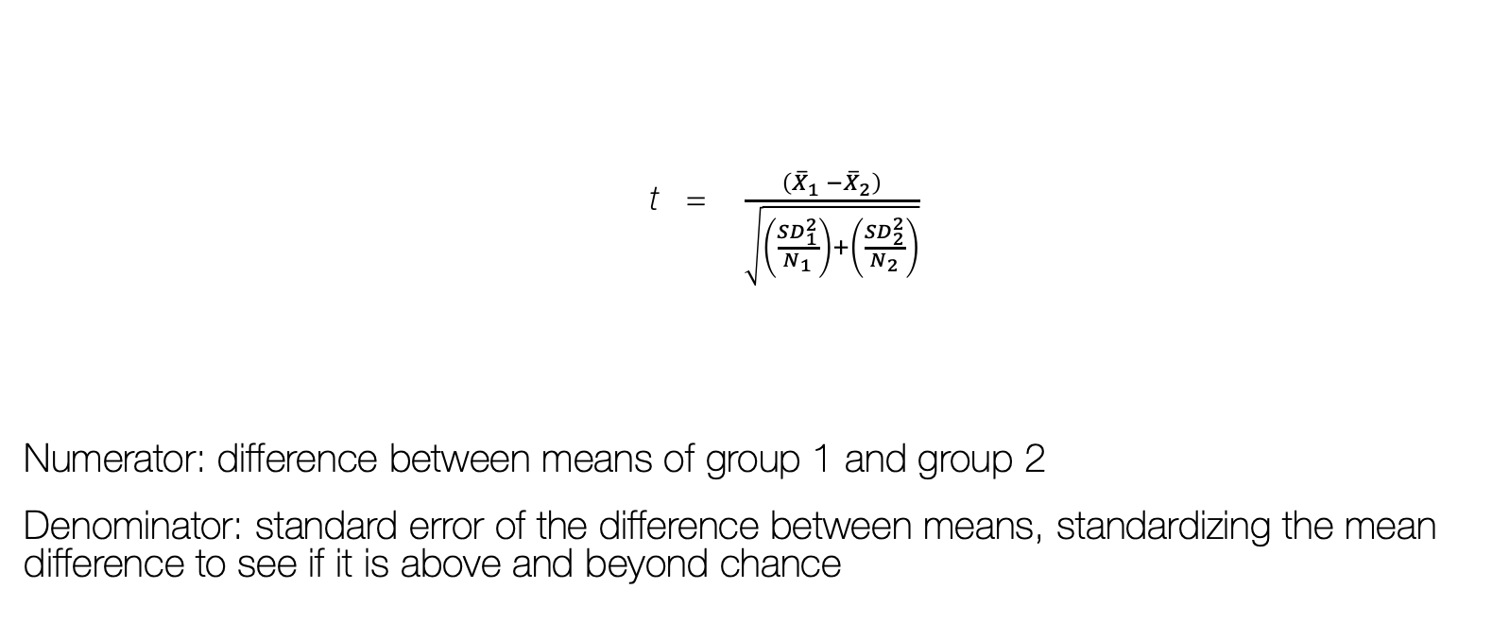
The T-test
t = $\frac{\left({\overline{X}}_{1} −{\overline{X}}_{2}\right)}{\sqrt{\left(\frac{{SD}_{1}^{2}}{N_{1}}\right)+\left(\frac{{SD}_{2}^{2}}{N_{2}}\right)}}$
Numerator: difference between means of group 1 and group 2
Denominator: standard error of the difference between means, standardizing the mean difference to see if it is above and beyond chance

Slide 77
The T-test
Compares two group means to see if there is a difference
Compares one group mean to the population mean
Compares one group mean to that same group’s mean at a later time
Compares one group mean to another group’s mean

Slide 78
The t-test
The one-sample t-test
Compares the mean of the sample to the population mean
The paired-samples t-test (repeated samples)
Compares mean of one group and time 1 to mean of that group at time 2
The independent samples t-test (two samples)
Compares mean of one group to mean of another

Slide 79
Independent Samples t-Test (Variable Types)
IV: nominal, ordinal (e.g. categorical/discrete)
Grouping variable
Only two groups/samples compared
DV: interval-ratio (e.g. continuous)

Slide 80
Independent Samples t-Test (Hypotheses)
H₀: No mean difference between two groups / mean of the DV does NOT vary by group
H₀: μ₁ = μ₂
H₁: Mean difference between two groups / mean of the DV DOES vary by group
H₁: μ₁ ≠ μ₂

Slide 81
H₀: Null Hypothesis
Any observed difference between samples is small and therefore due to chance/sampling error and doesn’t represent a true difference between populations
Notes:
Mu 1 is mean of group 1 in pop, mu 2 is mean of group 2 in pop

Slide 82
H₁: Alternative Hypothesis
Any observed difference between samples is not due to chance/sampling error and does represent a true difference between populations
Reject the null hypothesis (aka accept the research hypothesis)
Says the difference between samples is TOO BIG/TOO EXTREME to be the result of sampling error

Slide 83
T-TEST ASSUMPTIONS (cannot be violated)
Independence of Observations
Groups are not related or dependent upon each other. Case can’t be in more than one group. No ties between observations
Equal Sample (Group) Sizes
The number of cases in each group should be relatively similar.
If violated, use “pooled variance” t-test formula
Homogeneity of Variance
Both groups have approximately equal variances (SD²). The distributions (or spread) for the groups are approximately equal. Keppel & Zedeck (1989) suggest that variance comparison should not exceed 10:1 ratio.
Examine variances/SD in summary table of output
Normality of Distribution
Distribution must be relatively normal
Visual inspection using
Histogram
Normality (Q-Q) plots
Box-and-Whiskers plots
If violated, use “unequal variances assumed” formula, otherwise, use “equal variances assumed”
Notes:
If one is violated should be okay. But should make adjustments if necessary.
Don’t have triple whammy (violating final 3 – equal sample sizes, homogeneity of variances, and normality of distribution). You can violate 2 of 3 and still be okay, though.

Slide 84
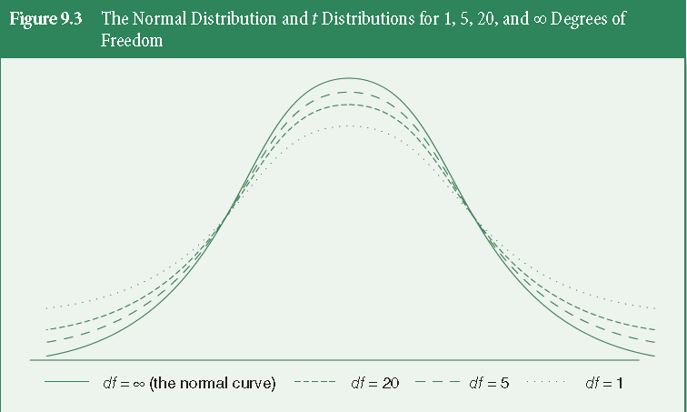
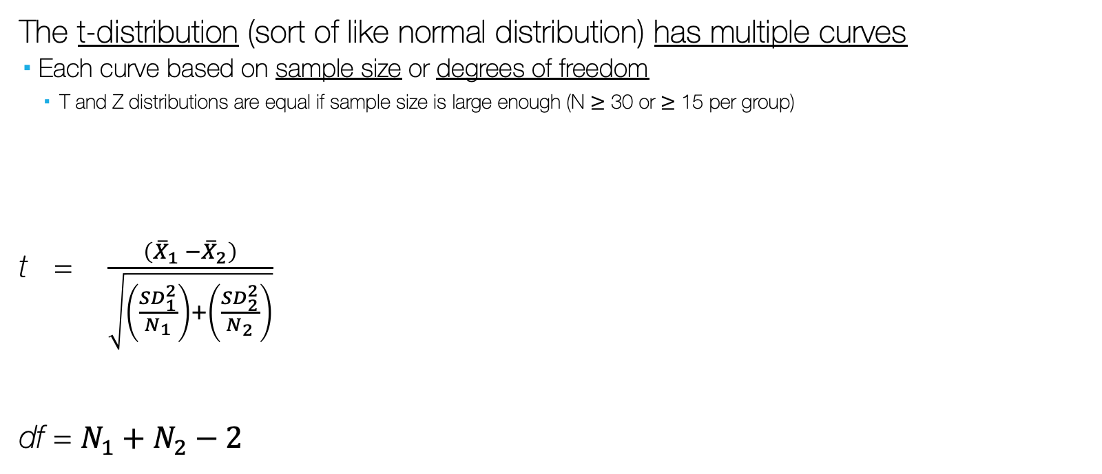
t-Test and the t-distribution
The t-distribution (sort of like normal distribution) has multiple curves
Each curve based on sample size or degrees of freedom
T and Z distributions are equal if sample size is large enough (N $≥$ 30 or $≥$ 15 per group)
t = $\frac{\left({\overline{X}}_{1} −{\overline{X}}_{2}\right)}{\sqrt{\left(\frac{{SD}_{1}^{2}}{N_{1}}\right)+\left(\frac{{SD}_{2}^{2}}{N_{2}}\right)}}$
df = $N_{1}+N_{2}−2$

Slide 85

Is the t-Test extreme?
Recall:
If | Z_{calculated} | $≥$ | Z_{critical} | , then…
Difference between mean of group 1 and mean of group 2 is so extreme that we can’t blame it on sampling error, therefore… H₀ is probably not true, so…
Z_{calculated} is in rejection region
Reject H₀
p $≤α$
Statistically significant difference

Slide 86

Is the t-Test extreme?
So, applied to t-Test:
If | t_{calculated} | $≥$ | t_{critical} | , then…
Difference between mean of group 1 and mean of group 2 is so extreme that we can’t blame it on sampling error, therefore… H₀ is probably not true, so…
t_{calculated} is in rejection region
Reject H₀
p $≤α$
Statistically significant difference

Slide 87

Is the t-Test extreme?
So, applied to t-Test:
If | t_{obtained} | $≥$ | t_{critical} | , then…
Difference between mean of group 1 and mean of group 2 is so extreme that we can’t blame it on sampling error, therefore… H₀ is probably not true, so…
t_{obtained} is in rejection region
Reject H₀
p $≤α$
Statistically significant difference

Slide 88

Is the t-Test extreme?
Also recall for Z, if we select $α$= .05:
If | Z_{calculated} | $≥$ | $±$1.96 | , then…
Difference between mean of group 1 and mean of group 2 is so extreme that we can’t blame it on sampling error, therefore… H₀ is probably not true, so…
Z_{calculated} is in rejection region
Reject H₀
p $≤$ .05
Statistically significant difference

Slide 89

Is the t-Test extreme?
However because t has multiple distributions, based on df, if we select $α$= .05:
We must refer to a table (Appendix T) to figure out what t_{critical} is.
Use your chosen H₁ (directional – one-tailed; non-directional – two-tailed)
Your $α$
Your df
Then, evaluate to see if | t_{obtained} | $≥$ | t_{critical} |

Slide 90
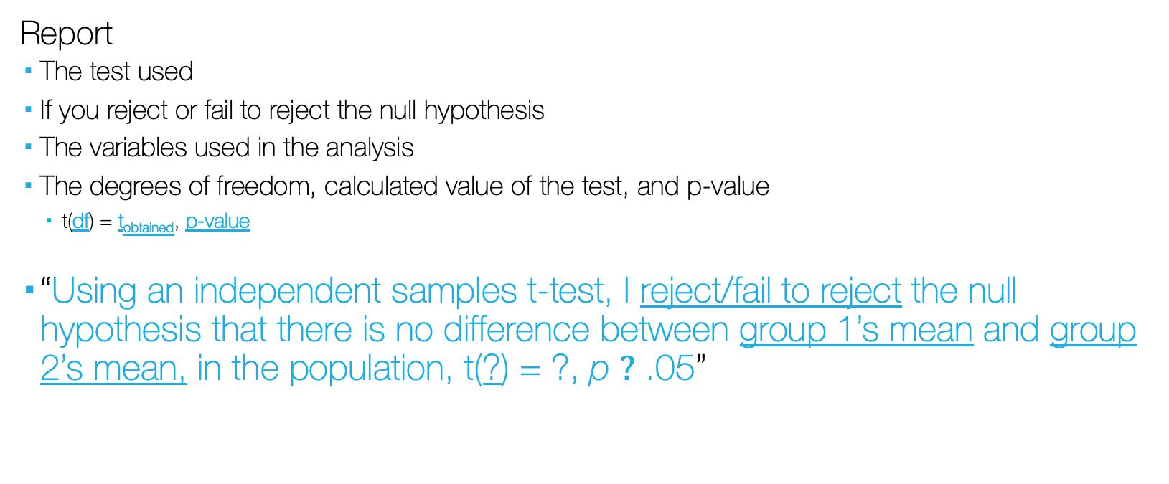
Reporting t
Report
The test used
If you reject or fail to reject the null hypothesis
The variables used in the analysis
The degrees of freedom, calculated value of the test, and p-value
t(df) = t_{obtained}, p-value
“Using an independent samples t-test, I reject/fail to reject the null hypothesis that there is no difference between group 1’s mean and group 2’s mean, in the population, t(?) = ?, p $?$ .05”

Slide 91
Example: Beers in the Home Fridge for Undergrads vs. grads
Undergrads: (list of 5 observations below)
3, 0, 2, 1, 5
Grads: (list of 5 observations below)
1, 6, 17, 9, 2

Slide 92

T-test and Confidence Intervals
We can modify the CI formula to create a confidence interval around the mean difference
CI = $\left({\overline{X}}_{1}−{\overline{X}}_{2}\right)±\text{t}\text{critical}{(SD}_{{\overline{X}}_{1}−{\overline{X}}_{2}})$

